Slide 1
Predicting Nba Regular season wins
Shaun Chaudhary
DAT-NYC-41

Slide 2
Outline
Build a model to predict the upcoming regular season win percentage of an NBA team given their previous season’s statistics
Many white papers have been written to try and develop a robust predictive model. Some techniques used:
Linear Regression – fivethirtyeight.com and Giarta, E et al. (2015)
Naïve Bayes Classification – Na Wei (2011)
Deep Learning / Neural Networks – Bernard, L et al. (2009)
NBA Base Knowledge
82 games in a regular season
48 minutes in a game (12 minutes / quarter)
5 players on the court per team

Slide 3
Summary
Identify data sources that have historical, clean NBA data
www.basketball-reference.com
Scraped data from the first few tables using pd.read_html and manually copied and pasted the rest of the data into csv files that are stored on my hard drive
Read into python and clean up data types / column headers
Convert numeric columns, remove miscellaneous unicode characters, and standardize column headers across each table
Merge individual tables of data on team name and year
Combine historical standings, offensive, defensive, all star, and first team all-nba data into a single DataFrame
Log transform features with continuous data and build Kernel Ridge Regression with 10-fold validation

Slide 4
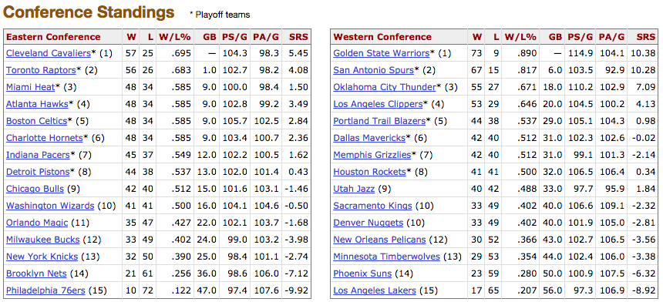
Raw data examples

Slide 5
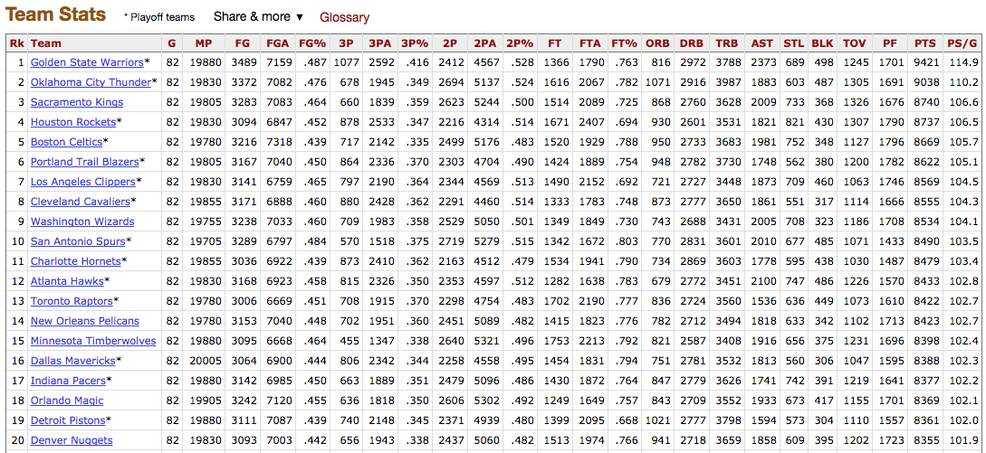
Raw data examples (ctd.)

Slide 6
MODEL
Chose to use Polynomial Kernel Ridge Regression with a log transformation
Kernel Ridge Regression combines a normal Ridge Regression and attempts to use the “kernel trick” to reduces the variance of the prediction results.
Ideal because we want the predicted win percentage for each team to be between 0 – 1.
Adding degrees to the linear regression (converting to polynomial)
Optimizing for mean squared error, I attempted to build features that accounted for polynomial transformations of degrees 1, 2, 3, and 4.
Degree == 2 had the best combination of lowest training MSE and test MSE
Log transforming the numerical features
Distribution of data is clustered around certain percentages, per game averages
Log transforming the data allowed the data to be more accurately distributed between 0 and 1.

Slide 7
Data dictionary
Feature | Feature Name | Data Type | Description | Log
2-Point FG % | twoP_Perc | float | Percent of 2 point field goals made in a season | ✔
Opp. 2-Point FG % | twoP_Perc_opp | float | Percent of opponent’s 2 point field goals made in a season | ✔
3-Point FG % | threeP_Perc | float | Percent of 3 point field goals made in a season | ✔
Opp. 3-Point FG % | threeP_Perc_opp | float | Percent of opponent’s 3 point field goals made in a season | ✔
Free Throw % | FT_Perc | float | Percent of free throws made in a season | ✔
Playoff Appearance | playoff_appearance | binary | 1 if qualified for playoffs
# of All Stars | all_star_count | integer | Number of all stars for that team
# of 1st Team All-NBA | all_nba_count | integer | Number of players that get selected for 1st team all NBA
Off. Rebounds / Game | ORB_G | float | Average offensive rebounds per game in a season | ✔
Steals / Game | STL_G | float | Average steals per game in a season | ✔
Turnovers / Game | TOV_G | float | Average turnovers per game in a season | ✔
Personal Fouls / Game | PF_G | float | Average personal fouls committed per game in a season | ✔
Opp. Off. Rebounds / Game | ORB_opp_G | float | Average offensive rebounds per game by opponents in a season | ✔
Opp. Personal Fouls / Game | PF_opp_G | float | Average opponent personal fouls committed per game in a season | ✔
Next Year Win Percentage | next_year_wl_perc | float | Target value: next season’s regular season win percentage

Slide 8

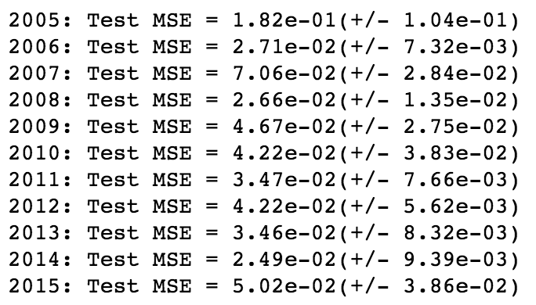
Optimizing the model
Tried a Random Forest Regression with n_estimators = 50 and k-folds = 3:
Focused on optimizing mean squared error for a polynomial Kernel Ridge Regression with log transformation:

Slide 9
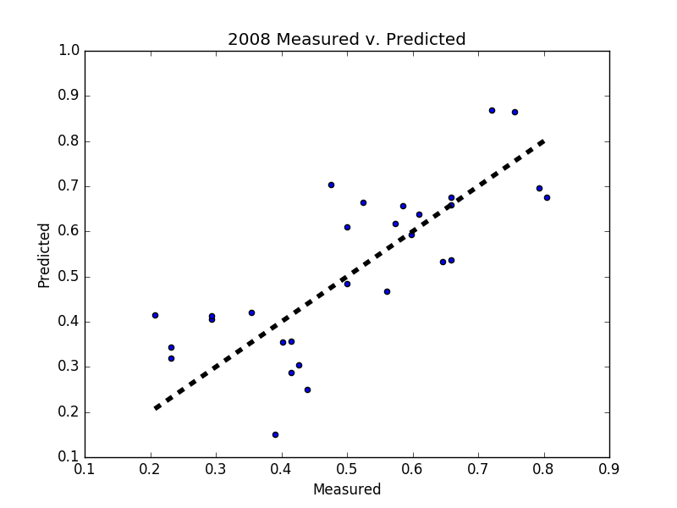
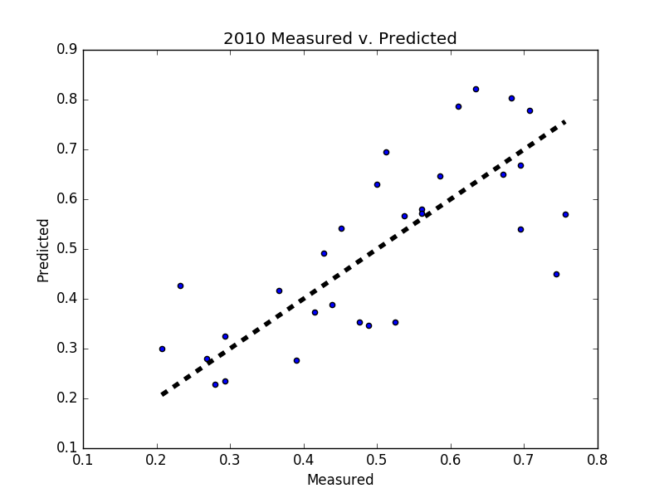
Evaluating results

Slide 10
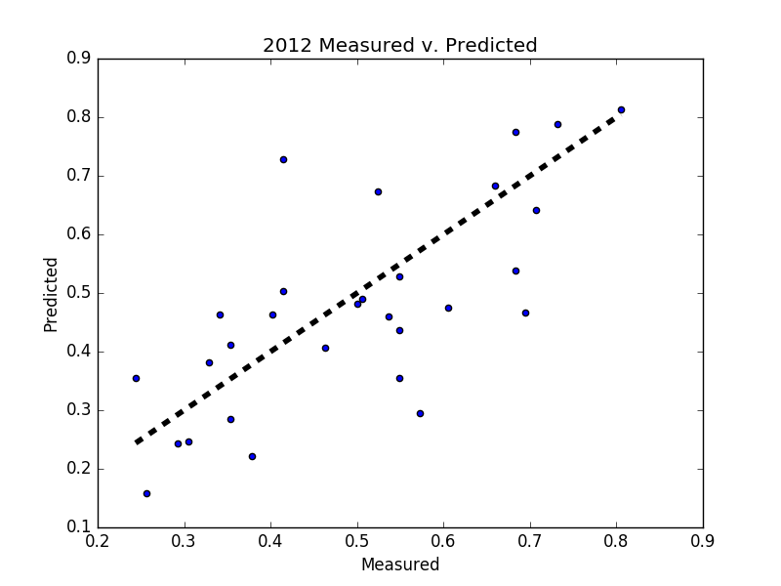
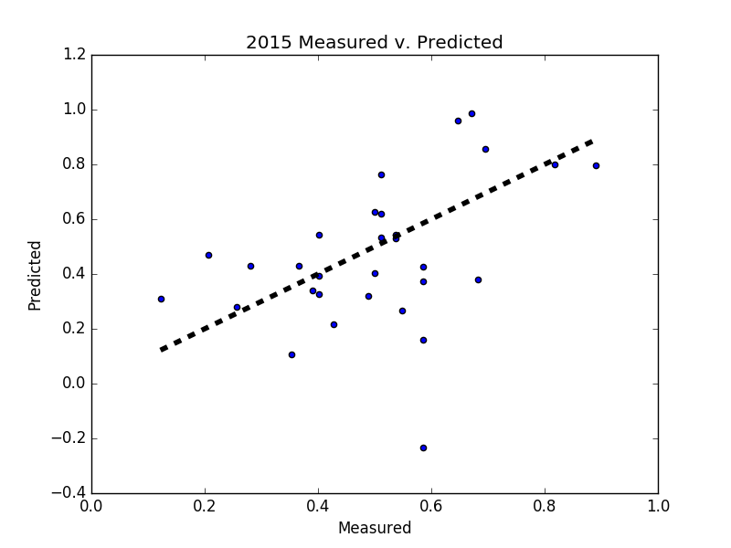
Evaluating results

Slide 11
Predict 2017 regular season
Eastern Conference | Win % | Games Won
Toronto Raptors | 0.618 | 51
Boston Celtics | 0.595 | 49
Cleveland Cavaliers | 0.586 | 48
Atlanta Hawks | 0.580 | 48
Indiana Pacers | 0.578 | 47
Charlotte Hornets | 0.549 | 45
Miami Heat | 0.544 | 45
Detroit Pistons | 0.539 | 44
Chicago Bulls | 0.403 | 33
Washington Wizards | 0.398 | 33
New York Knicks | 0.394 | 32
Orlando Magic | 0.383 | 31
Milwaukee Bucks | 0.376 | 31
Brooklyn Nets | 0.344 | 28
Philadelphia 76ers | 0.321 | 26
Western Conference | Win % | Games Won
Golden State Warriors | 0.677 | 56
San Antonio Spurs | 0.668 | 55
Oklahoma City Thunder | 0.611 | 50
Los Angeles Clippers | 0.601 | 49
Houston Rockets | 0.545 | 45
Dallas Mavericks | 0.529 | 43
Memphis Grizzlies | 0.520 | 43
Portland Trail Blazers | 0.501 | 41
Utah Jazz | 0.412 | 34
New Orleans Pelicans | 0.402 | 33
Sacramento Kings | 0.392 | 32
Minnesota Timberwolves | 0.391 | 32
Denver Nuggets | 0.390 | 32
Phoenix Suns | 0.359 | 29
Los Angeles Lakers | 0.336 | 28

Slide 12
Conclusions
Decent success building a polynomial regression model
Using the kernel ridge variety helped limit the predictions to between 0 and 1 (for the most part)
Using a log transformation allowed the distribution of normal NBA statistics to be more complete as opposed of clustering around average values
The average of a 10 game delta for predicting results over 10 years is not terrible given the lack of granularity for each team and the fact we are not accounting for end of season movement of players
Drawbacks of sci-kit learn is that I am unable to evaluate the statistical significance of individual features when using the pipeline functionality.

Slide 13
Next steps / extensions
Need to get more granular with my data and get same statistics but by player
This will allow me to better account for the future season’s resulting win percentage by accounting for free agency, trades, and retirements
Become more comfortable evaluating the statistical significance of coefficients when using the sklearn library
Attempt to build logistic regression that will evaluate probability that a team will win an in-season matchup and then aggregate end of season wins
Will allow additional analysis into individual matchups between all the teams
Try implementing a deep learning algorithm / neural network to create a predictive model

